Slide 1
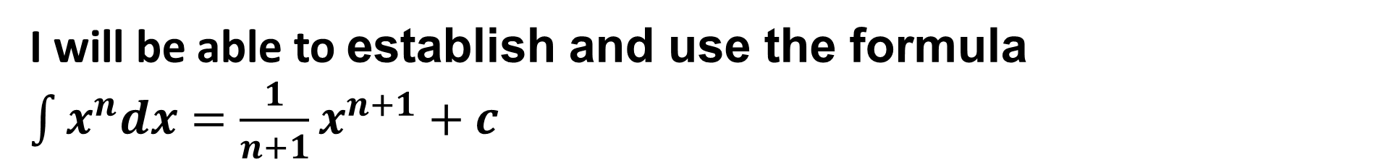
Learning Objective
I will be able to establish and use the formula $\int{x^{n}dx=\frac{1}{n+1}x^{n+1}+c}$
Success Criteria
At the end of the lesson, I will be able to:
identify anti-differentiation as the reverse of differentiation
use the notation ∫ 𝑓(𝑥)𝑑x for anti-derivatives or indefinite integrals
determine indefinite integrals of the form ∫ 𝑓(𝑎x − 𝑏)𝑑x

Slide 2
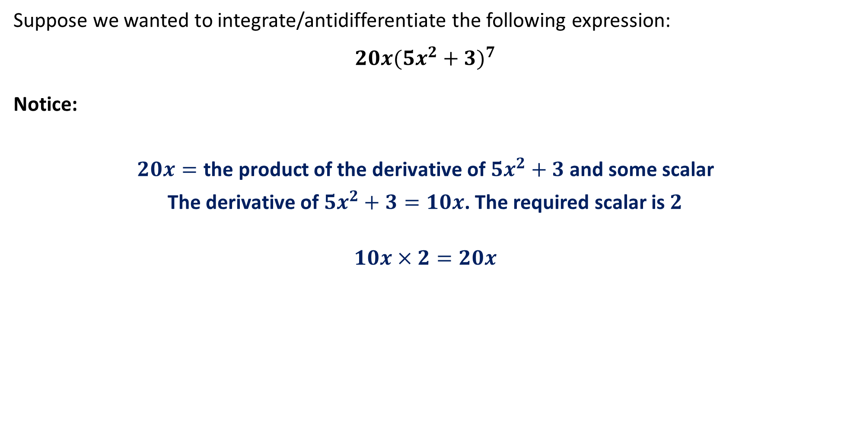
Integration Techniques
Suppose we wanted to integrate/antidifferentiate the following expression:
$$20x(5x^{2}+3)^{7}$$
Notice:
$20x=\text{the} \text{product} \text{of} \text{the} \text{derivative} \text{of} {5x}^{2}+3 \text{and} \text{some} \text{scalar}$
The derivative of ${5x}^{2}+3=10x$. The required scalar is $2$
$$10x×2=20x$$

Slide 3
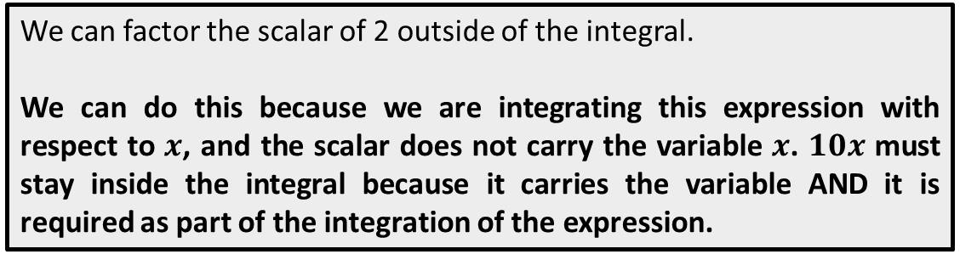
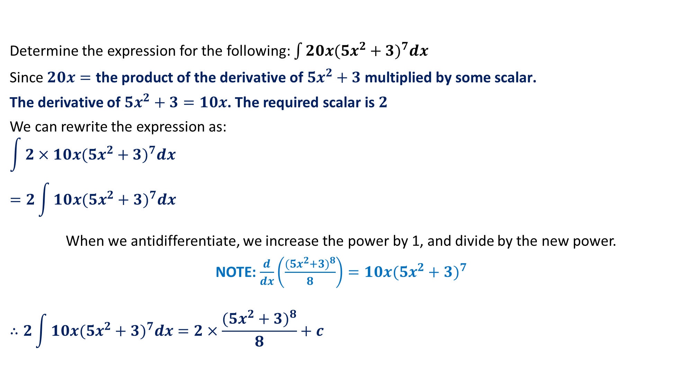
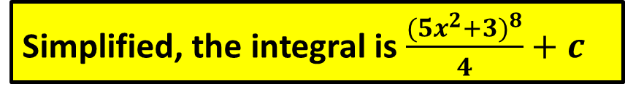
Integration Techniques – A Worked Example of Rearranging
Determine the expression for the following: $\int{20x(5x^{2}+3)^{7}dx}$
Since $20x=\text{the} \text{product} \text{of} \text{the} \text{derivative} \text{of} {5x}^{2}+3 \text{multiplied} \text{by} \text{some} \text{scalar}\text{.}$
The derivative of ${5x}^{2}+3=10x$. The required scalar is $2$
We can rewrite the expression as:
$$\int{2×10x(5x^{2}+3)^{7}dx}$$
$$=2\int{10x(5x^{2}+3)^{7}dx}$$
When we antidifferentiate, we increase the power by 1, and divide by the new power.
NOTE: $\frac{d}{dx}\left(\frac{(5x^{2}+3)^{8}}{8}\right)=10x(5x^{2}+3)^{7}$
$$∴2\int{10x(5x^{2}+3)^{7}dx}=2×\frac{(5x^{2}+3)^{8}}{8}+c$$
We can factor the scalar of 2 outside of the integral.
We can do this because we are integrating this expression with respect to $x$, and the scalar does not carry the variable $x$. $10x$ must stay inside the integral because it carries the variable AND it is required as part of the integration of the expression.
Simplified, the integral is $\frac{(5x^{2}+3)^{8}}{4}+c$

Slide 4
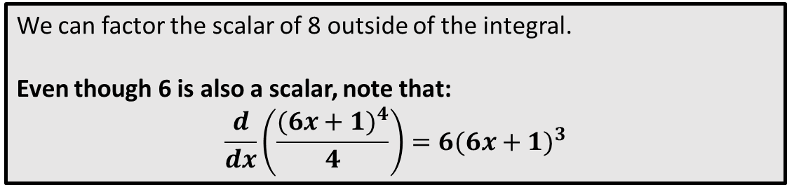
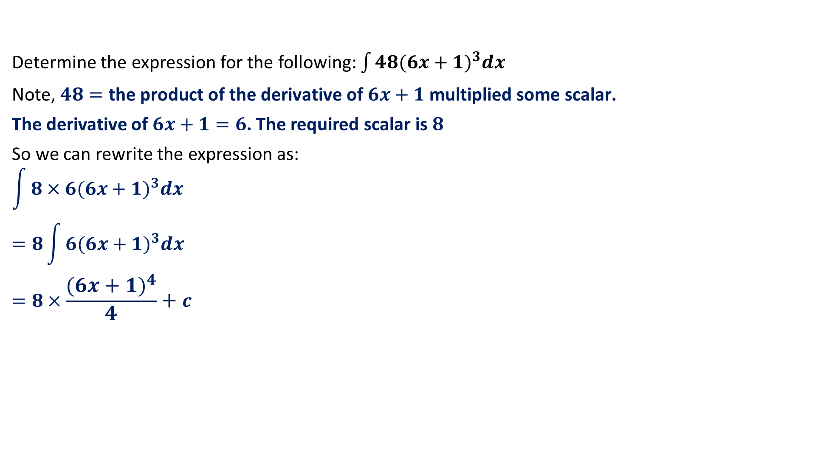
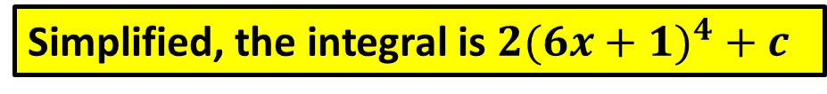
Integration Techniques – Another Worked Example of Rearranging
Determine the expression for the following: $\int{48(6x+1)^{3}dx}$
Note, $48=\text{the} \text{product} \text{of} \text{the} \text{derivative} \text{of} 6x+1 \text{multiplied} \text{some} \text{scalar}\text{.}$
The derivative of $6x+1=6$. The required scalar is $8$
So we can rewrite the expression as:
$$\int{8×6(6x+1)^{3}dx}$$
$$=8\int{6(6x+1)^{3}dx}$$
$$=8×\frac{(6x+1)^{4}}{4}+c$$
We can factor the scalar of 8 outside of the integral.
Even though 6 is also a scalar, note that:
$$\frac{d}{dx}\left(\frac{(6x+1)^{4}}{4}\right)=6(6x+1)^{3}$$
Simplified, the integral is $2(6x+1)^{4}+c$

Slide 5

Guided Practice
Determine the expressions for the following:
1) $\int{12x(1+x^{2})^{2}dx}$
2) $\int{20x(x^{2}−7)^{4}dx}$

Slide 6
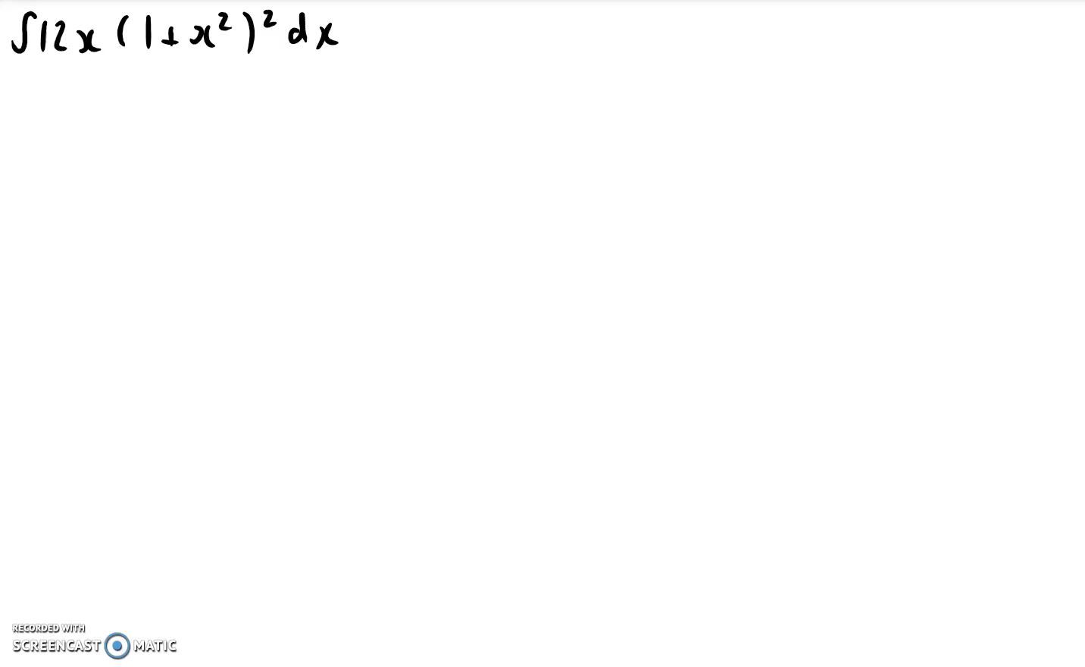
Guided Practice
Remember to keep the derivative of the
bracketed expression inside the integral!

Slide 7
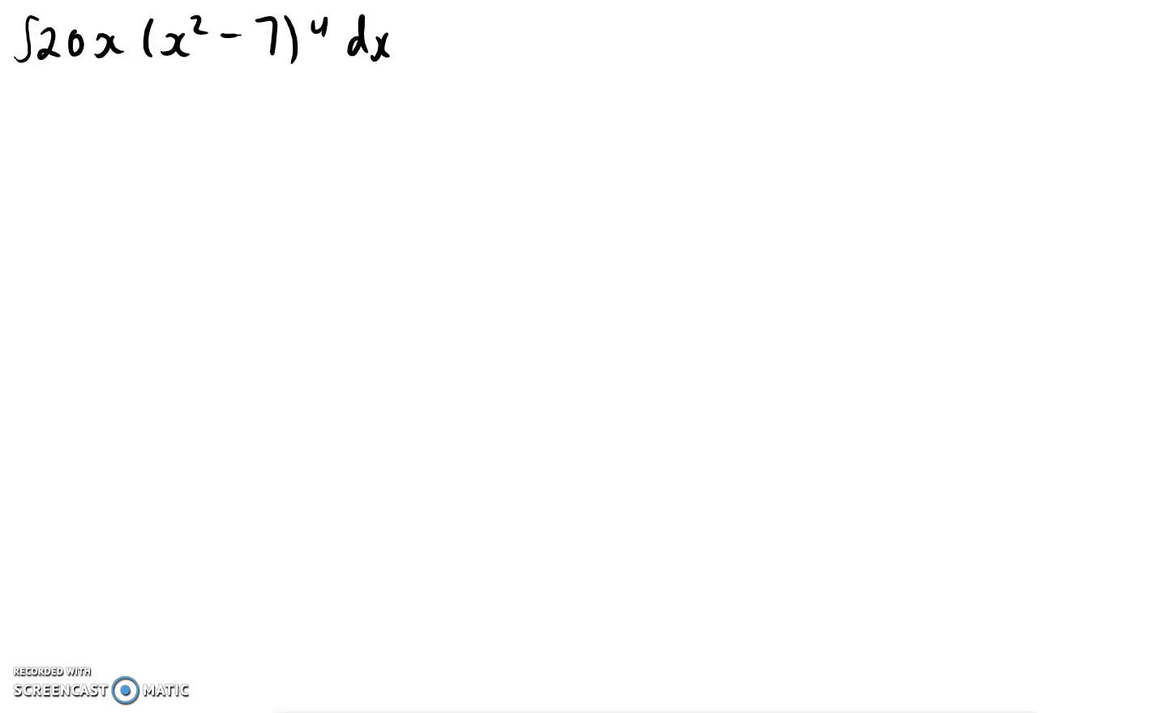
Guided Practice

Slide 8
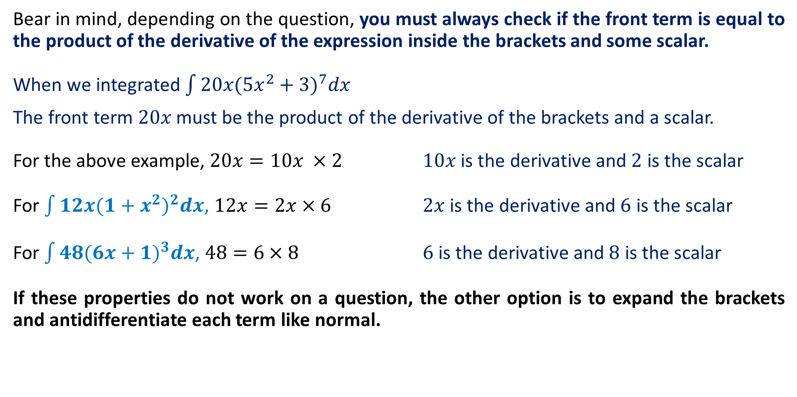
Does This Technique Always Work?
Bear in mind, depending on the question, you must always check if the front term is equal to the product of the derivative of the expression inside the brackets and some scalar.
When we integrated $\int{20x(5x^{2}+3)^{7}dx}$
The front term $20x$ must be the product of the derivative of the brackets and a scalar.
For the above example, $20x=10x ×2$ $10x$ is the derivative and $2$ is the scalar
For $\int{12x(1+x^{2})^{2}dx}$, $12x=2x×6$ $2x$ is the derivative and $6$ is the scalar
For $\int{48(6x+1)^{3}dx}$, $48=6×8$ $6$ is the derivative and $8$ is the scalar
If these properties do not work on a question, the other option is to expand the brackets and antidifferentiate each term like normal.

Slide 9
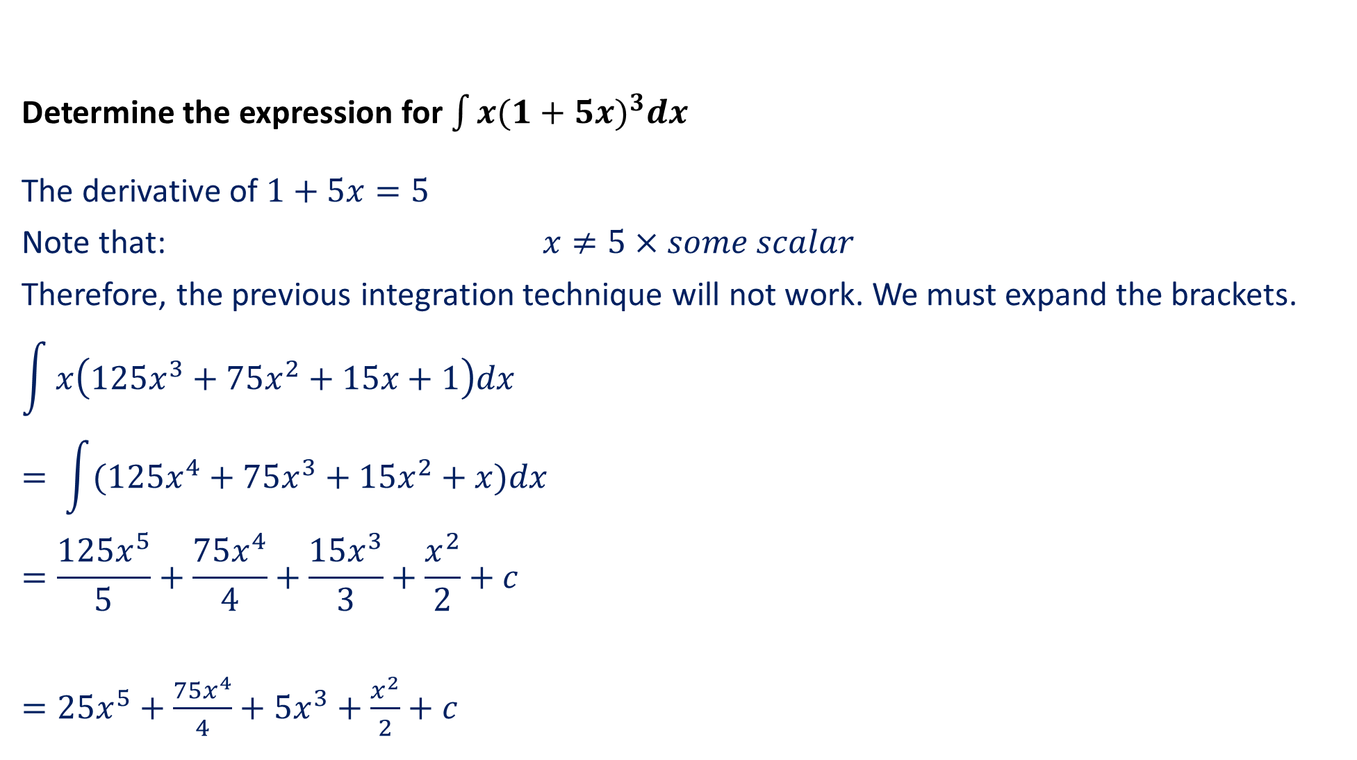
Does This Technique Always Work? (EXAMPLE)
Determine the expression for $\int{x(1+5x)^{3}dx}$
The derivative of $1+5x=5$
Note that: $x≠5×some scalar$
Therefore, the previous integration technique will not work. We must expand the brackets.
$$\int{x\left(125x^{3}+75x^{2}+15x+1\right)dx}$$
$$= \int{(125x^{4}+75x^{3}+15x^{2}+x)dx}$$
$$=\frac{125x^{5}}{5}+\frac{75x^{4}}{4}+\frac{15x^{3}}{3}+\frac{x^{2}}{2}+c$$
$=25x^{5}+$ $\frac{75x^{4}}{4}+5x^{3}+\frac{x^{2}}{2}+c$

Slide 10








Guided Practice
Find the antiderivative of${\left(3x+2\right)}^{3}$
Method 1:
Notice the derivative of $3x+2$ is 3
$$\int{{\left(3x+2\right)}^{3}}dx=\int{\frac{1}{3}×3×{\left(3x+2\right)}^{3}} dx$$
$$=\frac{1}{3}\int{3{\left(3x+2\right)}^{3}} dx$$
$$=\frac{1}{3}×\frac{{\left(3x+2\right)}^{4}}{4}+c$$
$$=\frac{{\left(3x+2\right)}^{4}}{12}+c$$

Slide 11
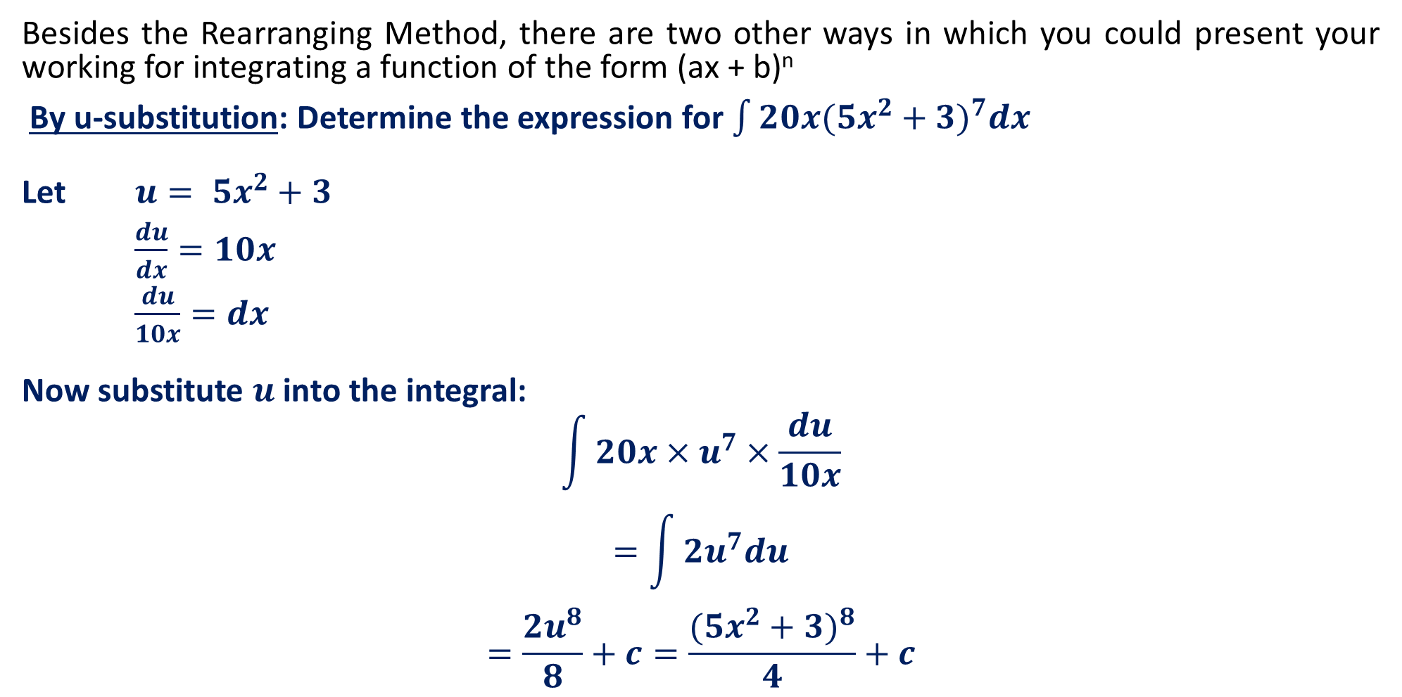

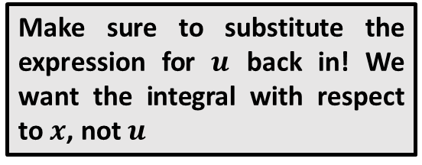
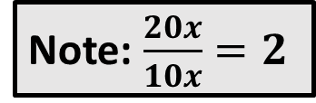
The $u$-Substitution Method
Besides the Rearranging Method, there are two other ways in which you could present your working for integrating a function of the form (ax + b)^{n}
By u-substitution: Determine the expression for $\int{20x(5x^{2}+3)^{7}dx}$
Let $u= 5x^{2}+3$
$\frac{du}{dx}=10x$
$\frac{du}{10x}=dx$
Now substitute $u$ into the integral:
$$\int{20x×u^{7}×\frac{du}{10x}}$$
$$=\int{2u^{7}du}$$
$$=\frac{2u^{8}}{8}+c=\frac{(5x^{2}+3)^{8}}{4}+c$$
Note: $\frac{20x}{10x}=2$
Make sure to substitute the expression for $u$ back in! We want the integral with respect to $x$, not $u$

Slide 12





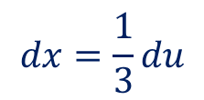


Guided Practice
Find the antiderivative of${\left(3x+2\right)}^{3}$
Method 2:
Let $u=3x+2$
$$\frac{du}{dx}=3$$
$$dx=\frac{1}{3}du$$
$$\int{{\left(3x+2\right)}^{3}}dx=\int{u^{3}}\frac{1}{3} du$$
$$=\frac{1}{3}\int{u^{3}}du$$
$$=\frac{1}{3}\left(\frac{u^{4}}{4}\right)+c$$
$$=\frac{1}{12}{\left(3x+2\right)}^{4}+c$$

Slide 13








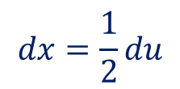
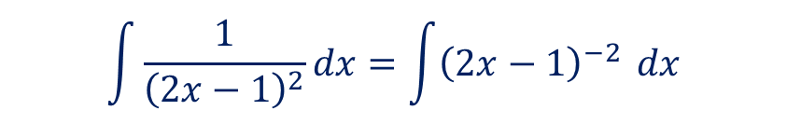
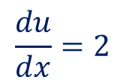

Guided Practice
Find the antiderivative of $\frac{1}{{\left(2x−1\right)}^{2}}$
Method 1:
Method 2:
Notice the derivative of $(2x−1)$ is 2
Let $u=2x−1$
$$\int{\frac{1}{{\left(2x−1\right)}^{2}}}dx=\int{{\left(2x−1\right)}^{−2}} dx$$
$$\frac{du}{dx}=2$$
$$=\frac{1}{2}\int{2{\left(2x−1\right)}^{−2}} dx$$
$$dx=\frac{1}{2}du$$
$$=\frac{1}{2}\left[\frac{{\left(2x−1\right)}^{−1}}{−1}\right]+c$$
$$\int{\frac{1}{{\left(2x−1\right)}^{2}}}dx=\int{u^{−2}} dx$$
$$=−\frac{1}{2(2x−1)}+c$$
$$=\frac{1}{2}\int{u^{−2}} du$$
$$=\frac{1}{2}\left(\frac{{ u}^{−1}}{−1}\right)+c$$
$$=−\frac{1}{2(2x−1)}+c$$

Slide 14









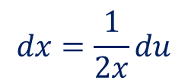
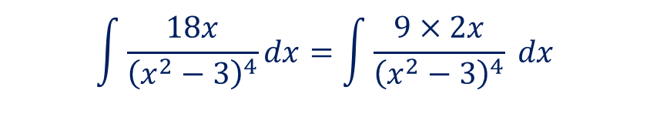
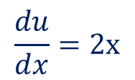

Guided Practice
Find the antiderivative of $\frac{18x}{{\left(x^{2}−3\right)}^{4}}$
Method 1:
Method 2:
Notice the derivative of $x^{2}−3$is $2x$
Let $u=x^{2}−3$
$$\int{\frac{18x}{{\left(x^{2}−3\right)}^{4}}}dx=\int{\frac{9×2x}{{\left(x^{2}−3\right)}^{4}}} dx$$
$$\frac{du}{dx}=2x$$
$$dx=\frac{1}{2x}du$$
$$=9\int{2x{\left(x^{2}−3\right)}^{−4}} dx$$
$$\int{\frac{18x}{{\left(x^{2}−3\right)}^{4}}}dx=\int{\frac{18x}{u^{4}}} dx$$
$$=9\left[\frac{{\left(x^{2}−3\right)}^{−3}}{−3}\right]+c$$
$$=\int{\frac{18x}{u^{4}}}×\frac{1}{2x}du$$
$$=−\frac{3}{{\left(x^{2}−3\right)}^{3}}+c$$
$$=\int{9u^{−4}}du$$
$$=9\left[\frac{u^{−3}}{−3}\right]+c$$
$$=−\frac{3}{{\left(x^{2}−3\right)}^{3}}+c$$

Slide 15








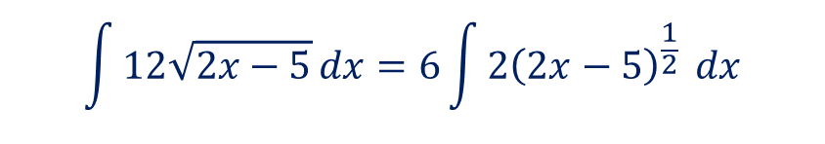

Guided Practice
Find the antiderivative of $12\sqrt{2x−5}$
Method 1:
Method 2:
Notice the derivative of $2x−5$is $2$
Let $u=2x−5$
$$\int{12\sqrt{2x−5}}dx=6\int{2{\left(2x−5\right)}^{\frac{1}{2}}} dx$$
$$\frac{du}{dx}=2$$
$$dx=\frac{1}{2}du$$
$$=6\left[\frac{{\left(2x−5\right)}^{\frac{3}{2}}}{\frac{3}{2}}\right]+c$$
$$\int{12\sqrt{2x−5}}dx=6\int{u^{\frac{1}{2}}} du$$
$$=6\left[\frac{u^{\frac{3}{2}}}{\frac{3}{2}}\right]+c$$
$$=4{\left(2x−5\right)}^{\frac{3}{2}}+c$$
$$=4{\left(2x−5\right)}^{\frac{3}{2}}+c$$

Slide 16



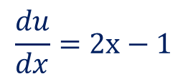


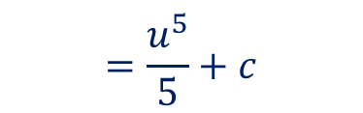
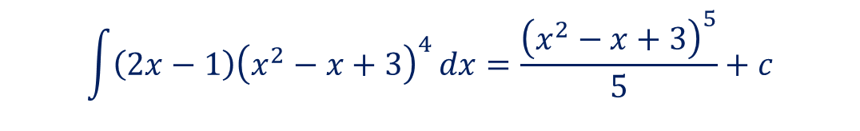

Guided Practice
Find the antiderivative of $\left(2x−1\right){\left(x^{2}−x+3\right)}^{4}$
Method 1: (rule of thumb – look at the function with the higher power)
Method 2:
Notice the derivative of $x^{2}−x+3$ is $2x−1$
Let $u=x^{2}−x+3$
$$\int{\left(2x−1\right){\left(x^{2}−x+3\right)}^{4}}dx=\frac{{\left(x^{2}−x+3\right)}^{5}}{5}+c$$
$$\frac{du}{dx}=2x−1$$
$$(2x−1)dx=du$$
$$\int{\left(2x−1\right){\left(x^{2}−x+3\right)}^{4}}dx$$
$$=\int{u^{4}}\left(2x−1\right)dx$$
$$=\int{u^{4}}du$$
$$=\frac{u^{5}}{5}+c$$
$$=\frac{{\left(x^{2}−x+3\right)}^{5}}{5}+c$$

Slide 17
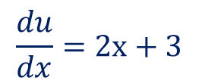







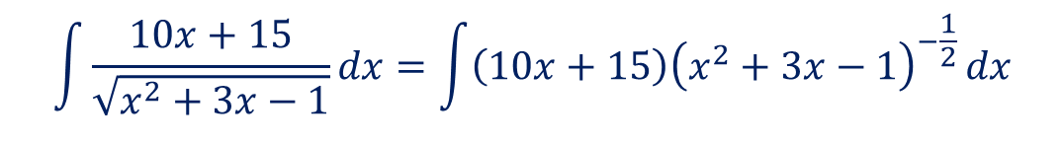

Guided Practice
Find the antiderivative of $\frac{10x+15}{\sqrt{x^{2}+3x−1}}$
Method 2:
Method 1:
Let $u=x^{2}+3x−1$
Notice the derivative of $x^{2}+3x−1$ is $2x+3$
$$\frac{du}{dx}=2x+3$$
$$\int{\frac{10x+15}{\sqrt{x^{2}+3x−1}}}dx=\int{\left(10x+15\right){\left(x^{2}+3x−1\right)}^{−\frac{1}{2}}}dx$$
$$(2x+3)dx=du$$
$$\int{\frac{10x+15}{\sqrt{x^{2}+3x−1}}}dx=5\int{\left(2x+3\right)u^{−\frac{1}{2}}}dx$$
$$=5\int{\left(2x+3\right){\left(x^{2}+3x−1\right)}^{−\frac{1}{2}}}dx$$
$$=5\int{u^{−\frac{1}{2}}}du$$
$$=\frac{5{\left(x^{2}+3x−1\right)}^{\frac{1}{2}}}{\frac{1}{2}}+c$$
$$=5\left[\frac{u^{\frac{1}{2}}}{\frac{1}{2}}\right]+c$$
$$=10\sqrt{x^{2}+3x−1}+c$$
$$=10\sqrt{x^{2}+3x−1}+c$$

Slide 18
Independent Practice
Complete Cambridge Ex 6C Q1 only
Extra Worksheet to complete on Connect

